Slide 1
StadiumVision
Mobile SDK
Overview For
App Developers
Cisco Sports and Entertainment (SESG)
April 2012

Slide 2
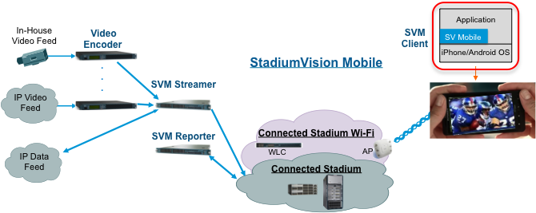
StadiumVision Mobile - Overview
Cisco StadiumVision Mobile (SVM) enables reliable and scalable delivery of low-delay video and data streams to WiFi devices at venues
A Venue Operator typically configures and operates SVM, Connected Stadium Wi-Fi and Connected Stadium components
The mobile app developer is responsible for obtaining the SVM SDK from Cisco, working with the Venue Operator on configuration dependencies and integrating the SVM Client
  SVM Client functionality includes: automatic session discovery, reception and recovery of multicast data and video streams, playout of video sessions, delivery of data objects, and periodic updating and uploading of client statistics

Slide 3
SDK Overview
SVM Client 1.0 highlights:
  Automatic discovery of up to 4 audio/video sessions and 4 data sessions
  Playout of 1 video stream
  Reception of up to 4 periodically updated data streams (eg, game scores, ads)
  Support for configurable video playout window size and location
  Support for Rewind and Return to Live control
  Real-time statistics of network and media playout performance
  Sample apps with local stream playout to emulate stadium WiFi conditions
  Available for iOS version 4.0 and later, and Android version 2.1 or later
SDK components:
  Library – iOS/Android executable with configuration files
  Developer’s Guide and API Reference – documentation on use of SVM library
  Sample applications – application source code which demonstrates use of core SVM Client functionality. Application includes a stream sending mechanism and sample video and data streams to emulate stream behavior at crowded venues
    Note: sample application does not require Wi-Fi configuration used at venues

Slide 4
Android Overview

Slide 5
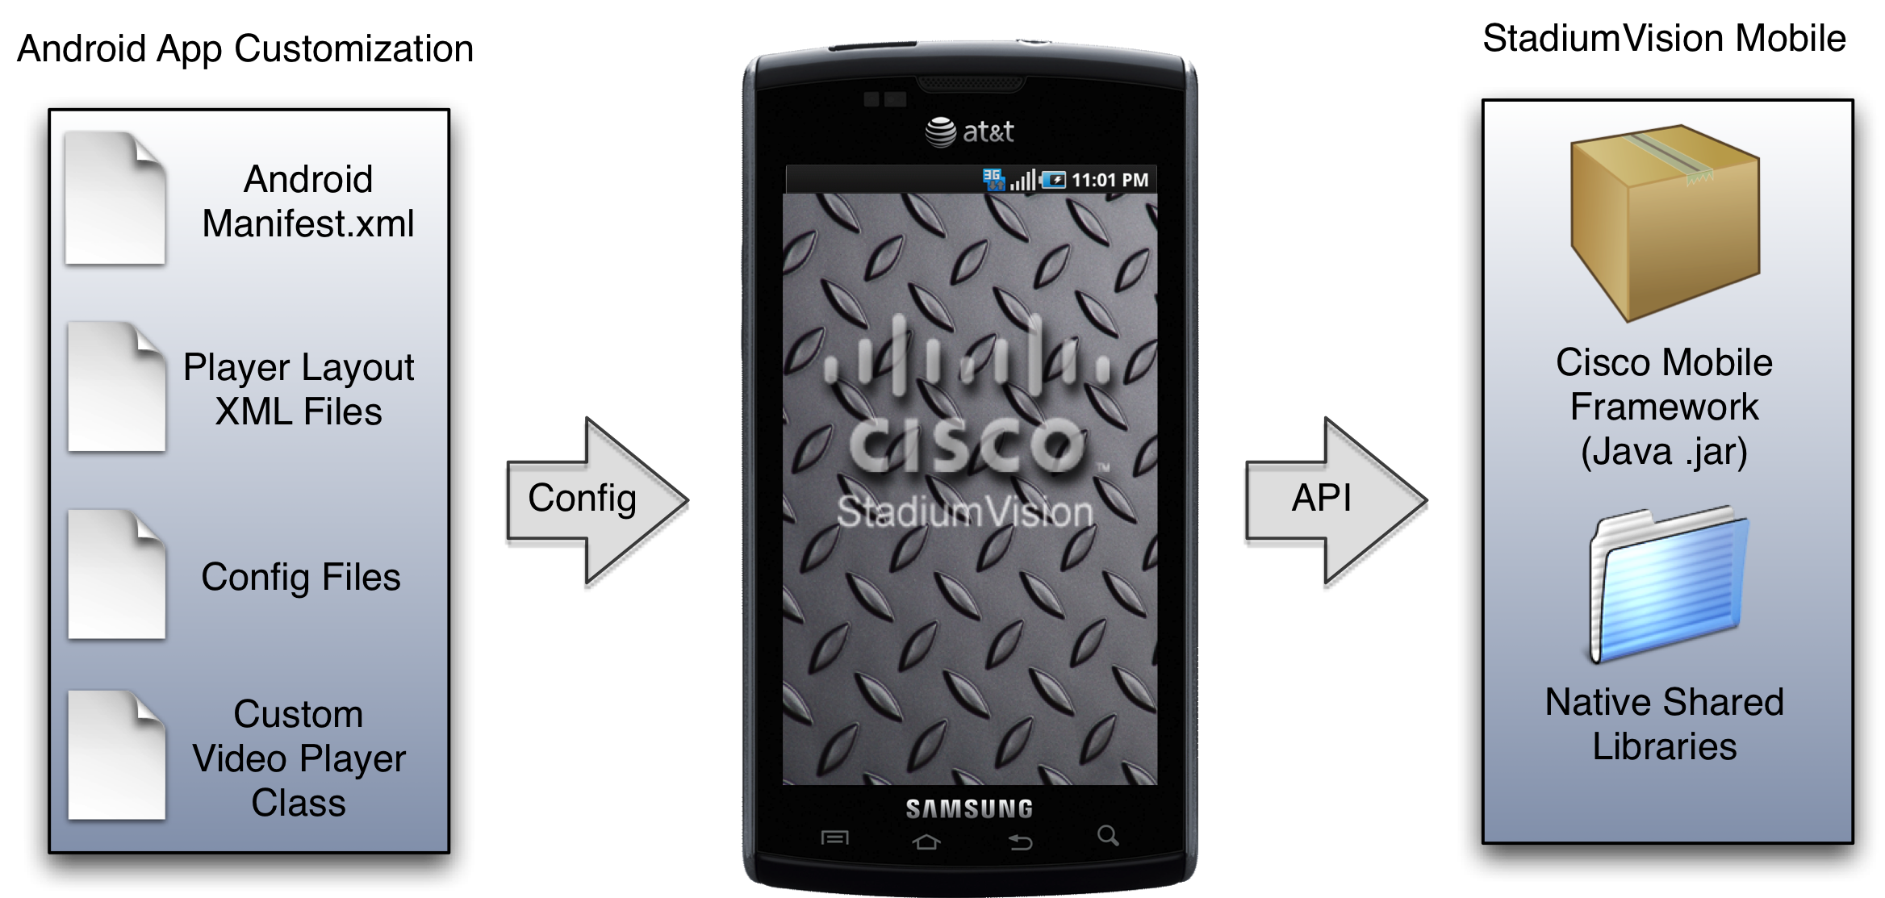
SVM Client Integration Overview
Designed to be an easy drop-in
Import the StadiumVision Mobile SDK
Customize the layout of the Cisco video player

Slide 6
StadiumVision Mobile Classes
“StadiumVisionMobile” acts as a custom Android “App Context”
“SVMVideoPlayerActivity” is a customizable stand-alone video player Activity

Slide 7
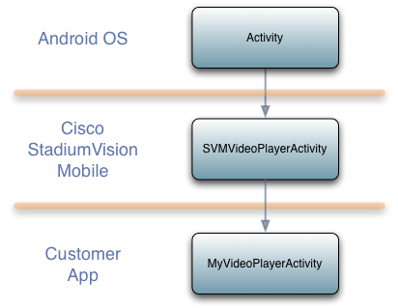
Video Player Activity Inheritance
Android “Activity” class used as the base class
App Developer app can extend the Cisco StadiumVision Mobile classes

Slide 8
StadiumVisionMobile API
Each API call returns an ‘SVMStatus’ object whenever applicable
All ‘StadiumVisionMobile’ API methods are static methods. Sample methods given below…
API Method Name | API Method Description
start | Start the StadiumVision Mobile SDK
getVideoChannelArray | Get the array of available video channels
getDataChannelArray | Get the array of available data channels
addDataChannelObserver | Registers an observer class to receive data for a particular data channel
onPause | Forwards each Android Activity’s ‘onPause’ life-cycle notification to the StadiumVision Mobile SDK to declare the client Android app as “active”
getStats | Gets a HashMap of the current StadiumVision Mobile SDK stats. The StadiumVision Mobile SDK provides a rich set of stats that may be used to understand the network performance and user quality of experience.

Slide 9
Video Player API
The ‘SVMVideoPlayerActivity’ class can be extended and customized. Sample API methods given below…
The “SVMVideoPlayerActivity” class provides methods that can be overridden for easy player notifications. Sample API methods given below…
API Method Name | API Method Description
setVideoSurfaceView | Sets the Android UI “SurfaceView” where video frames will get rendered
playVideoChannel | Starts playback of a particular video channel, changing channels on subsequent calls
Overridden Method | Description
onVideoPlayerStarted() | Called when the video player has been completely initialized and has started playback of the configured video channel
onBufferingActive() | Called as an event when video buffering has started

Slide 10
App Developer Responsibilities (1 / 2)

Slide 11
App Developer Responsibilities (2 / 2)
Customer app handles...
  Getting the list of video channels
  Displaying the list of video channels
  Handling user gestures for selecting video channels
  Adding video overlays and layouts
  Handling user gestures to control video overlays

Slide 12
Data Channel API
Sample data channel methods given below…
The client application receives an array of channel objects and can observe up to 4 channels by registering a class to receive callbacks for all data received on the channel(s)
API Method Name | API Method Description
start | Start the StadiumVision Mobile SDK
getDataChannelArray | Get the array of available data channels
addDataChannelObserver | Registers an observer class to receive data for a particular data channel

Slide 13
iOS Overview

Slide 14
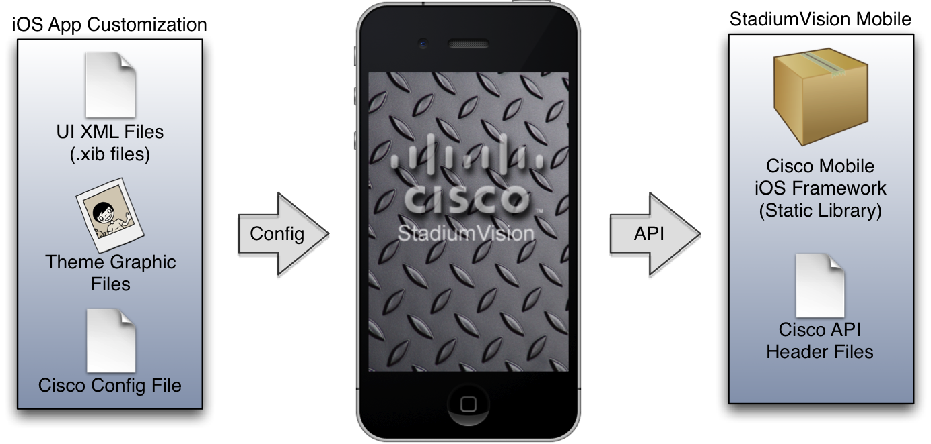
Client App Integration Overview
The iOS SDK is provided as a set of static libraries, header files, and an a sample iOS app (with a complete Xcode project)
The iOS SDK video player is customizable

Slide 15
StadiumVision Mobile Classes
The singleton “StadiumVisionMobile” class provides the top-level API to start, configure, and stop the framework
Video View Controller classes are provided to play the video channels and allow for customer customization

Slide 16
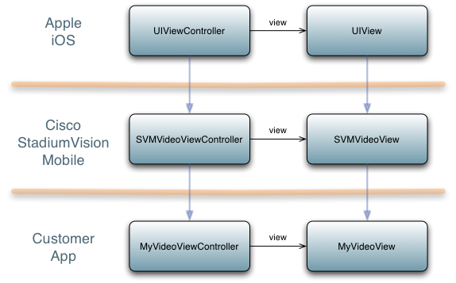
Video View Controller Inheritance
iOS “UIViewController” and “UIView” classes used as base classes
Customer app can extend the Cisco StadiumVision Mobile classes

Slide 17
StadiumVisionMobile API
Each API call returns an ‘SVMStatus’ object whenever applicable
All API calls require a reference to the ‘StadiumVisionMobile’ API singleton using the ‘sharedInstance’ static method. Sample API methods given below…
API Method Name | API Method Description
sharedInstance | Gets a reference to the API singleton class used for all API calls
start | Starts the StadiumVision Mobile SDK
addVideoChannelListDelegate | Registers a callback delegate to receive all video channel list updates
addDataChannelObserver | Registers an observer class to receive data for a particular data channel
statsForSVM | Gets an NSDictionary of the current StadiumVision Mobile SDK stats. The StadiumVision Mobile SDK provides a rich set of stats that may be used to understand the network performance and user quality of experience.

Slide 18
Video Player API
The ‘SVMVideoVideoController’class can be extended and customized
  Sample ‘SVMVideoPlayerActivity’ API methods given below…
API Method Name | API Method Description
renderVideoView | Sets the iOS UI video view where video frames will get rendered
playChannel | Starts playback of a particular video channel, changing channels on subsequent calls

Slide 19
SVM API for Data Channel Feature
Sample data channel methods given below…
The client application registers to receive callbacks whenever the data channel list is updated.
API Method Name | API Method Description
sharedInstance | Gets a reference to the API singleton class used for all API calls
start | Starts the StadiumVision Mobile SDK
addDataChannelListDelegate | Registers a callback delegate to receive all data channel list updates
addDataChannelObserver | Registers an observer class to receive data for a particular data channel

Slide 20
What the SDK Handles
The StadiumVision Mobile SDK needs to be started by calling a single SDK API method (“start”)
The StadiumVision Mobile SDK automatically handles...
  Dynamic video channel discovery and notification
  Dynamic data channel discovery and notification
  Automatic SDK shutdown / restart in response to WiFi up / down events
  Automatic SDK shutdown / restart in response to iOS life-cycle events
  Management of multicast network data threads
  On-demand management of video / audio decoding threads

